Slide 1
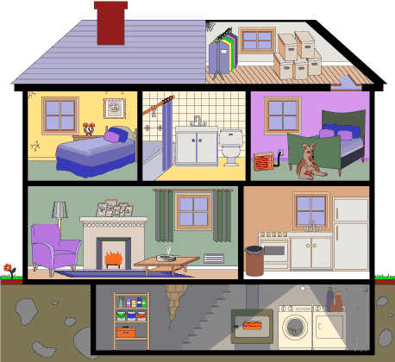
Parts of
the House

Slide 2
Let’s check the answers!
1. champion
2. romance
3. tours
4. boys
5. girls
6. where
7. side by side
8. dance
9. dance
10. dancing
11. war
12. coinciDANCE

Slide 3
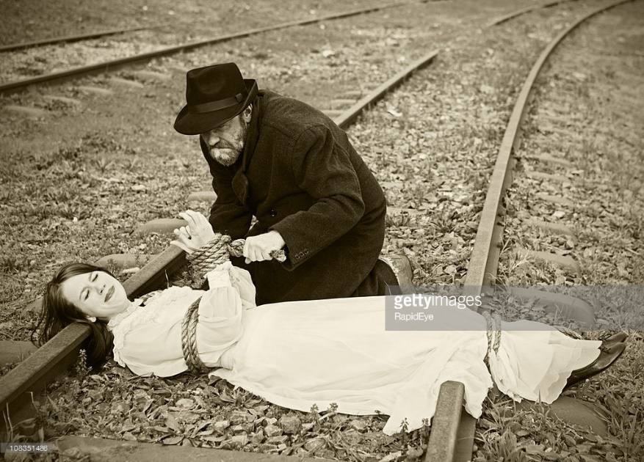
damsel in distress落難女子
a young woman who is in trouble and needs a man's help

Slide 4
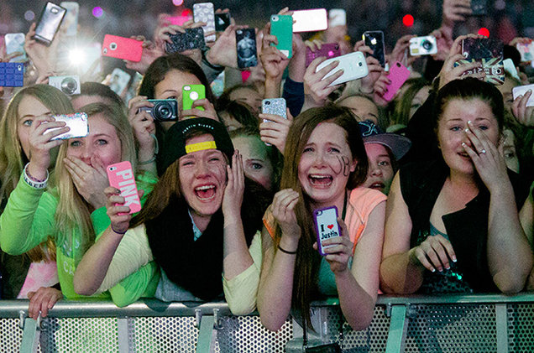
Idolize偶像化
to admire and respect someone very much, often too much

Slide 5
lessons教訓
an experience that teaches you how to behave better in a similar situation in the future

Slide 6
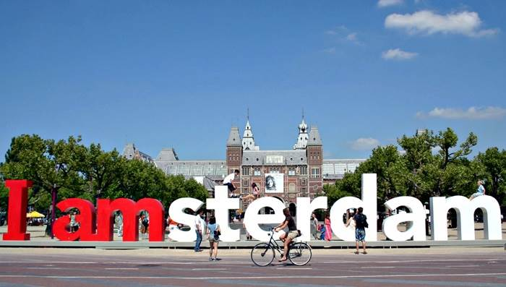
Amsterdam阿姆斯特丹
the capital city of the Netherlands, situated in the western part of the country

Slide 7
perchance可能/或許
by chance; possibly

Slide 8
crooked glance不誠懇的一瞥
dishonest and quick short look

Slide 9
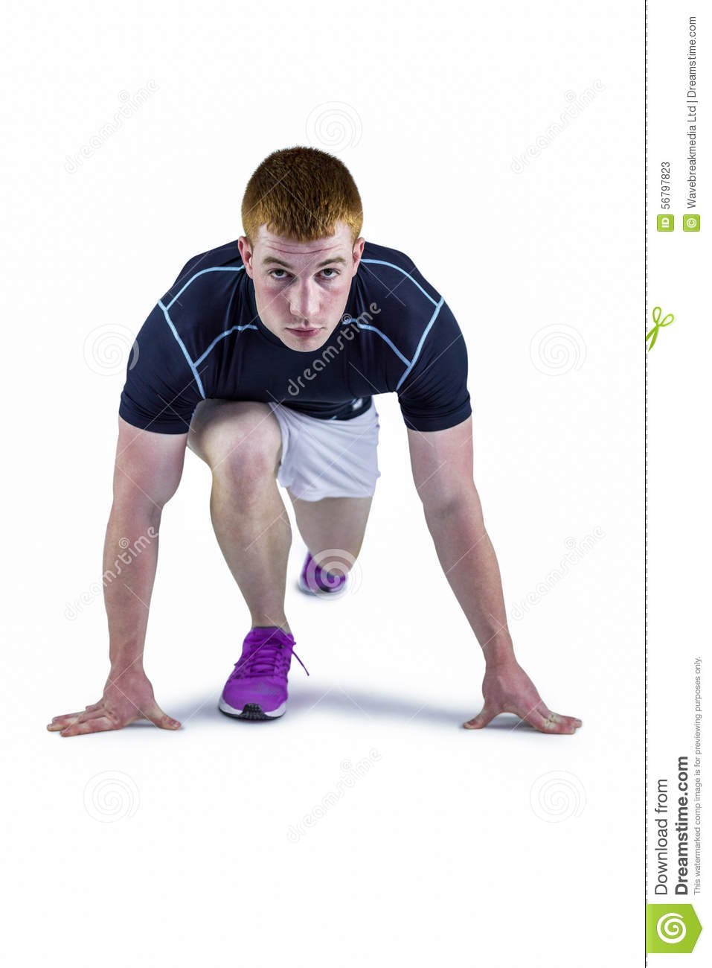
Stance 姿勢/位置
a pose / position

Slide 10
faithful忠誠的
firm and not changing in your friendship with or support for a person or an organization, or in your belief in your principles

Slide 11
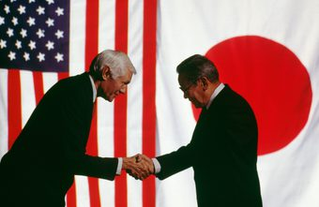
diplomat外交官
official whose job is to represent one country in another, and who usually works in an embassy

Slide 12
celebrate慶祝
to take part in special enjoyable activities in order to show that a particular occasion is important

Slide 13
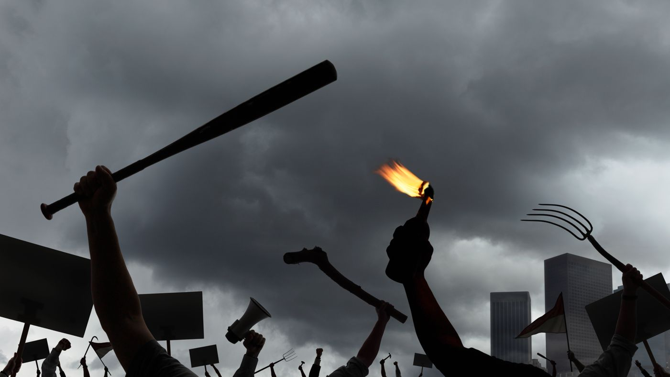
violence暴力
actions or words that are intended to hurt people

Slide 15
a room with a bath
bathroom

Slide 16
a room with a bed
bedroom

Slide 17
a room where we can have dinner
dinner
dining
sounds alike
dining room

Slide 18
a room where we can live
living room

Slide 19
a room where we can cook
kitchen

Slide 20
a place where we play and plant
yard

Slide 21
window

Slide 22
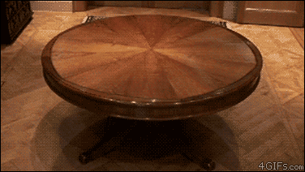
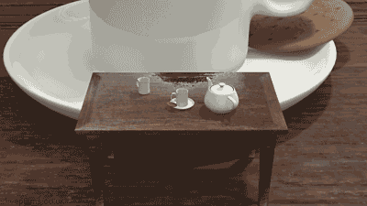
table

Slide 23
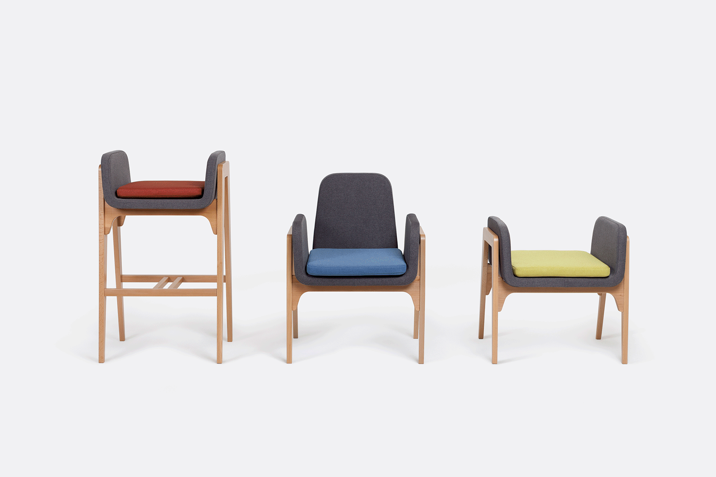
chair

